Slide 1

Thank you for downloading InVivoStat. We hope you find it easy to use and informative! This wizard gives a short introduction to the package and shows you how to perform statistical analyses using InVivoStat.

Slide 2
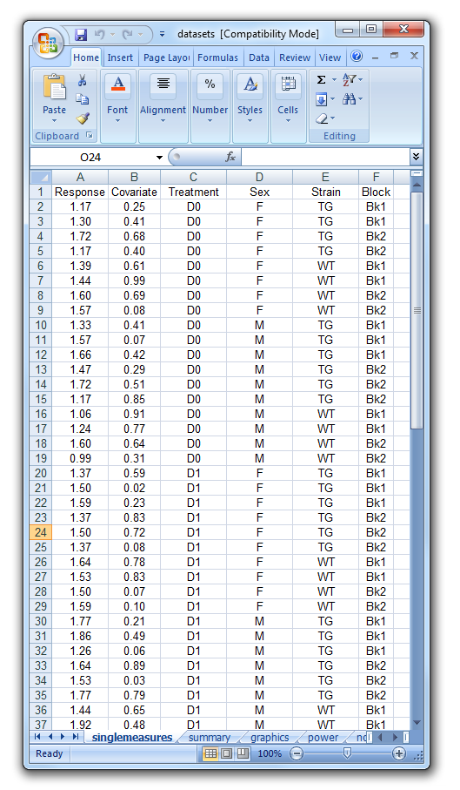
To begin with your dataset needs to be formatted correctly.
There are two main formats, depending on whether or not the response is measured repeatedly for each animal.
In both formats the responses are placed in a single column (within the dataset) with separate ‘indicator’ columns denoting animal characteristics, treatment factors and other nuisance variables.
In this scenario each animal is measured once and each row of the dataset corresponds to an animal.

Slide 3
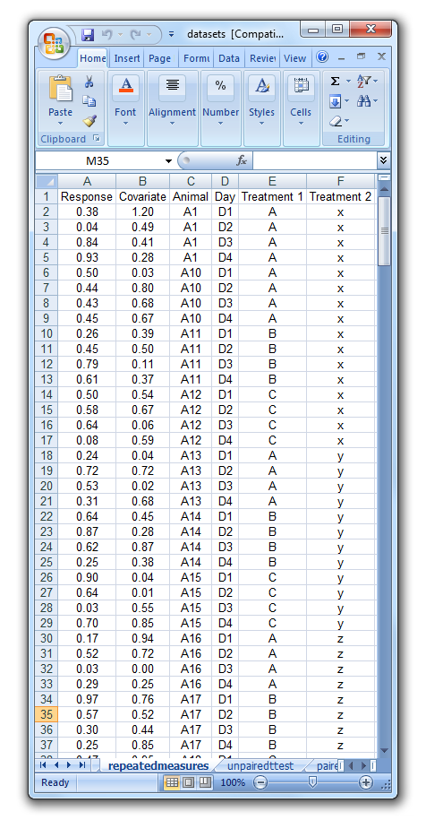
The second commonly used format is needed when animals are measured repeatedly, perhaps over time.
In this dataset all the responses are placed in one column. Also required is a column indicating the animal (there are multiple rows per animal), a column indicating the repeated factor level (i.e. the Day variable) and also columns to indicate the Treatment factors.

Slide 4
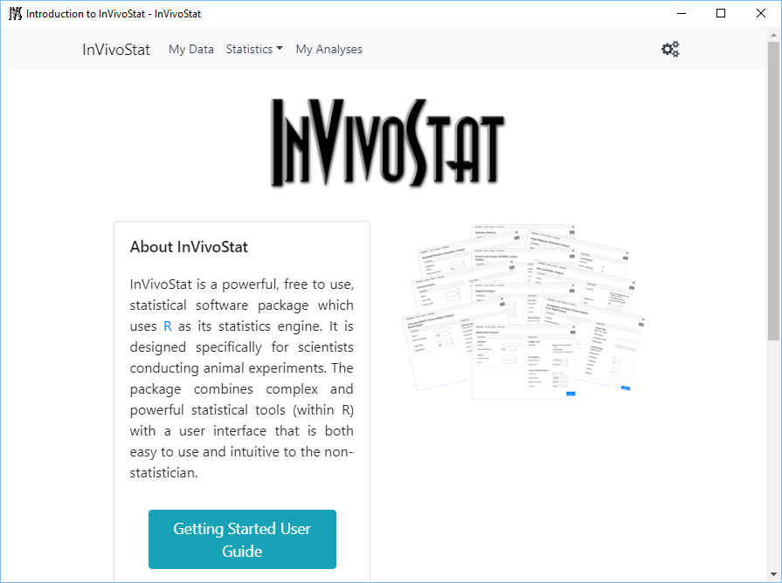
To start using InVivoStat, first you need to upload your dataset. Do this by clicking on the ‘My Data’

Slide 5
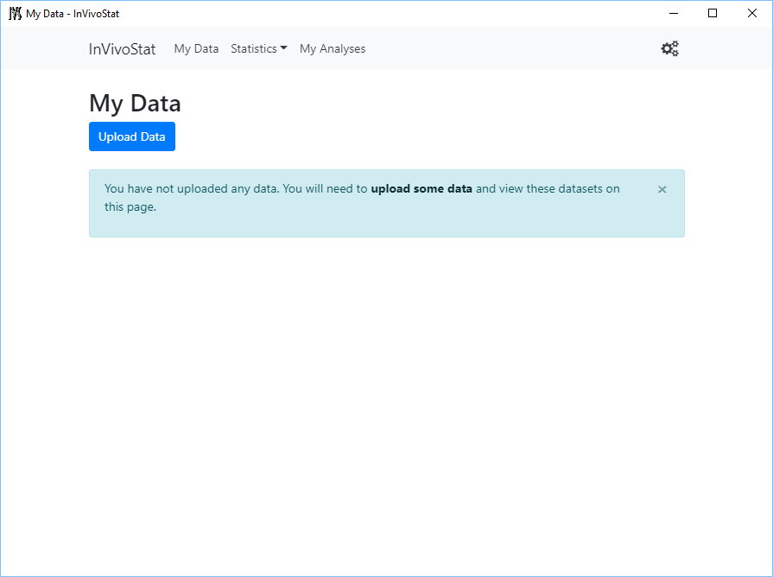
Click on the ‘Upload Data’ button

Slide 6
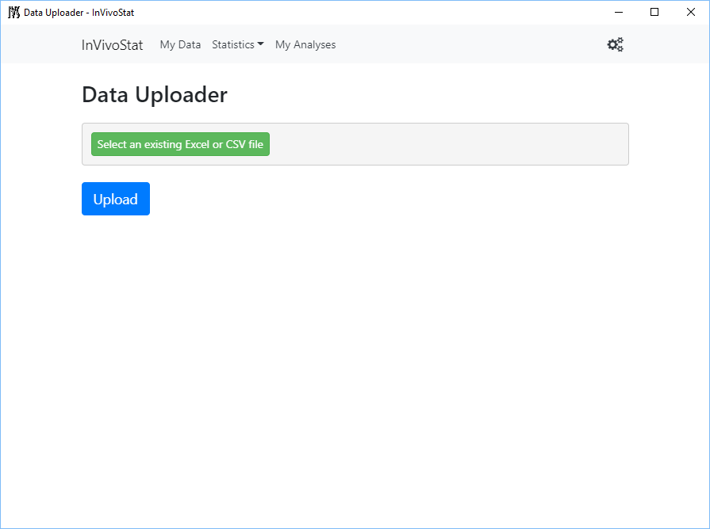
Click on ‘Select an existing Excel or CSV file’ to choose the file to import

Slide 7
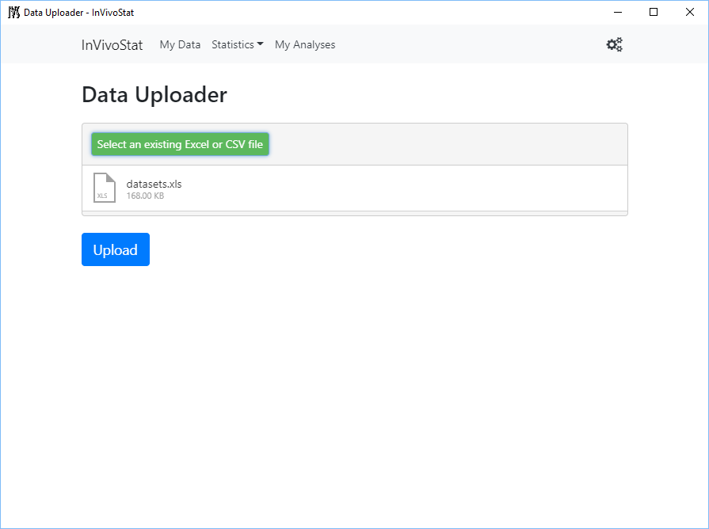
Once the file has been selected, click on ‘Upload’
If your Excel sheet has multiple sheets you will be asked which one to import

Slide 8
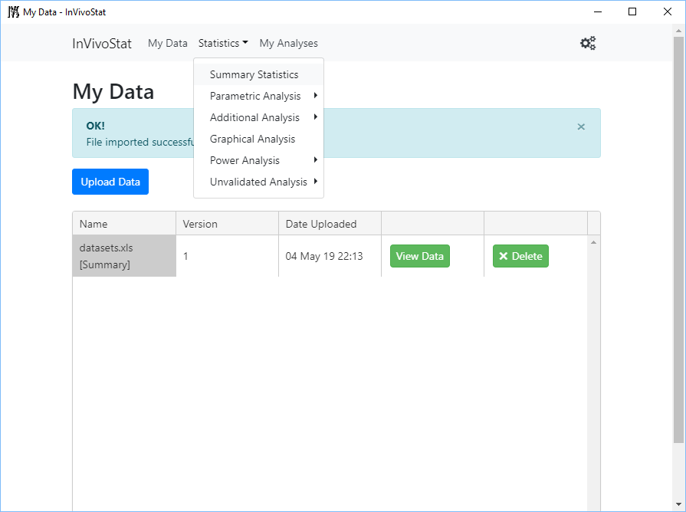
Analyses can be now selected from the ‘Statistics’ drop-down list
You will be asked which dataset to analyse from the available uploaded datasets

Slide 9
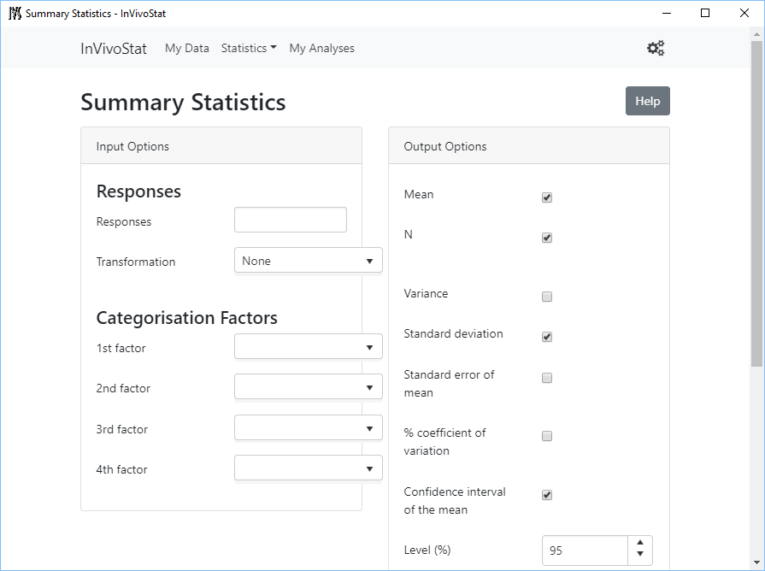
Using each analysis module involves following a similar procedure.
Each module has a ‘Input Options’ (where the analysis options are selected) and a ‘Output Options’ where results are selected.

Slide 10
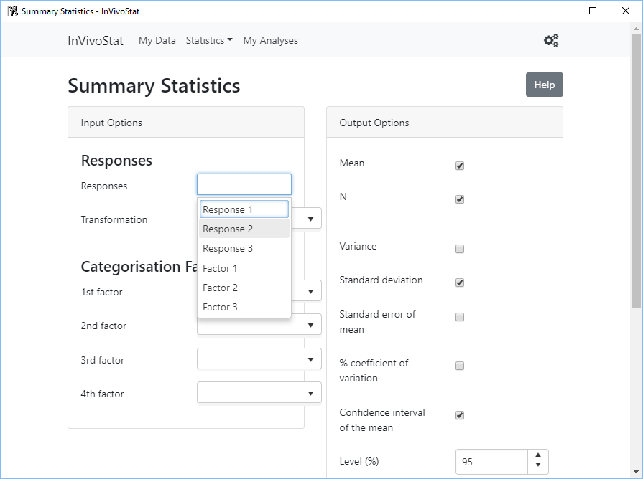
Variables are selected by clicking on the relevant box and choosing the variable(s) from the dataset.
Output options can be selected as required.

Slide 11
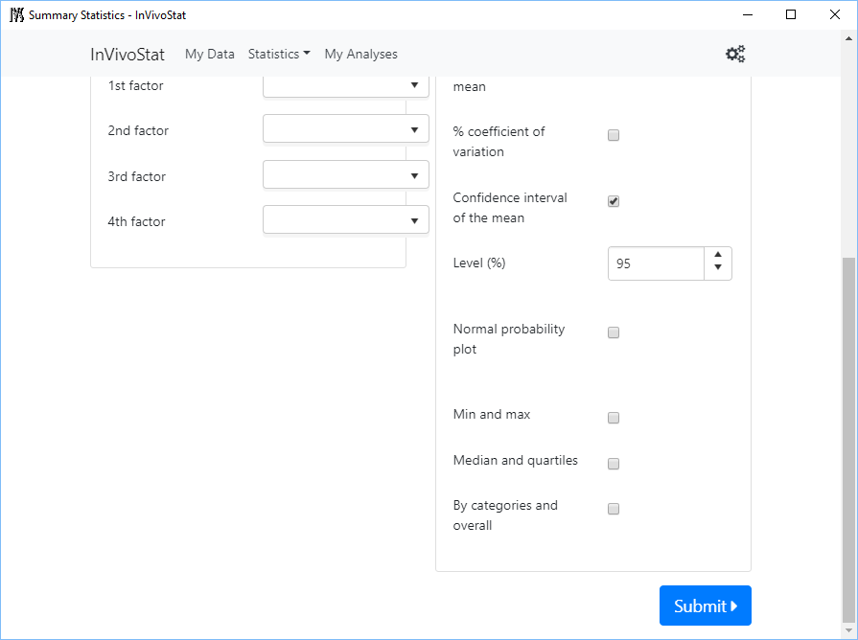
Once all options are selected , click on the ‘Submit’ button to run the analysis

Slide 12
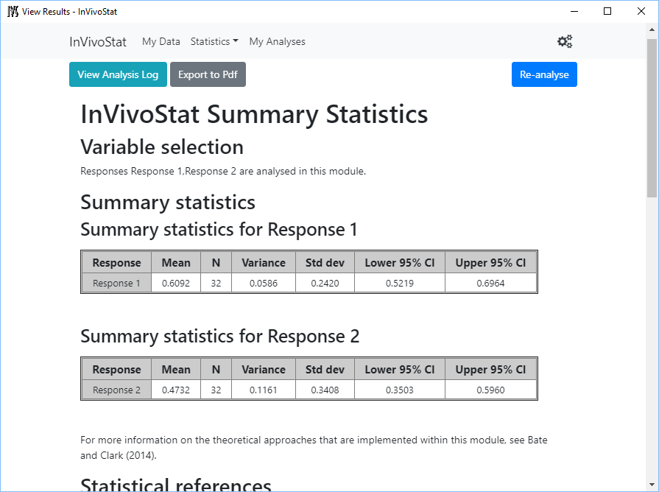
The output includes numerical results alongside information on the analysis employed and how to interpret the results generated.

Slide 13
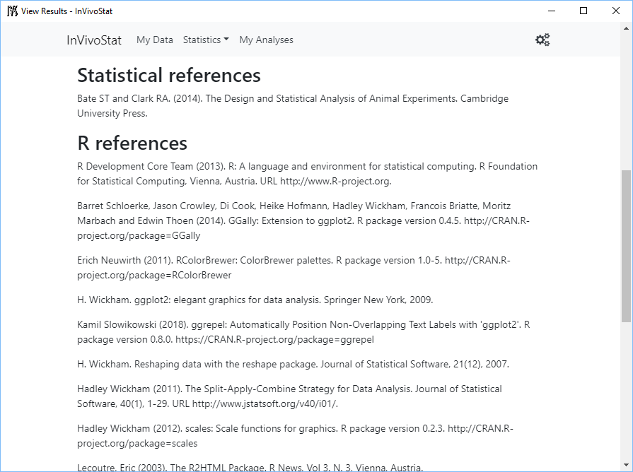
The output also includes statistical references

Slide 14
The HTML output can be saved directly, or a pdf copy of the output generated

Slide 15
Other default output options, such as the default properties of the graphical plots and other numerical output selections, can be changed here

Slide 16
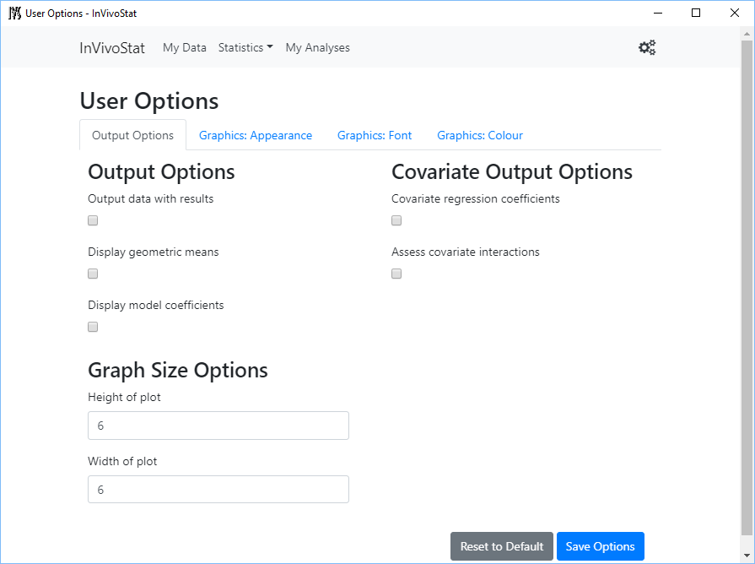
Options include fonts and colour schemes on plots, as well as displaying the dataset alongside the results

Slide 17
Each module has a help button that will take you to the on-line tipsheets for more information on the individual modules.

Slide 18
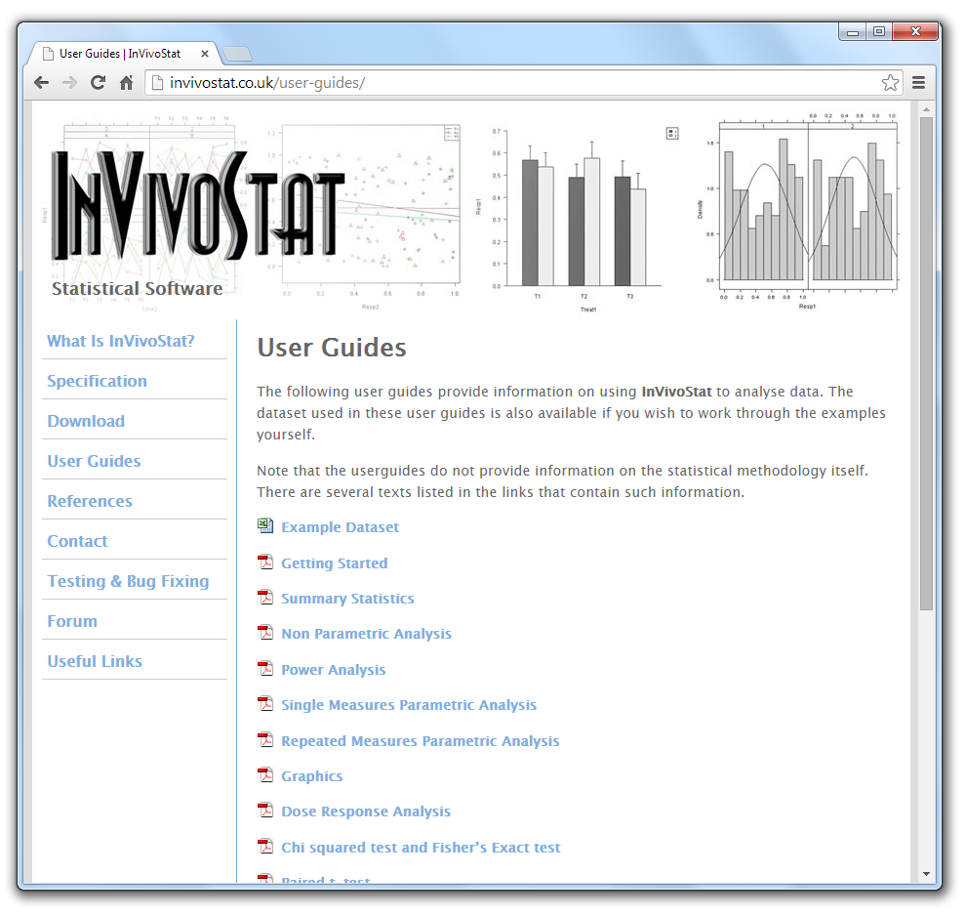
Tipsheets are available for all of InVivoStat’s modules at the website.

Slide 19
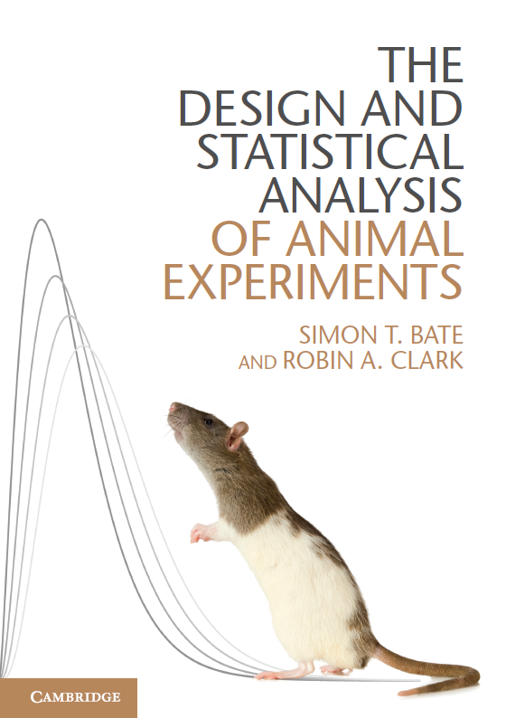
Further information regarding the methodology implemented within InVivoStat can be found in:
The Design and Analysis of Animal Experiments
Bate and Clark
Cambridge University Press (2014)

